Slide 1
Gratitude
Holly A. Traver, PhD
Dept. of Cognitive Science

Slide 2
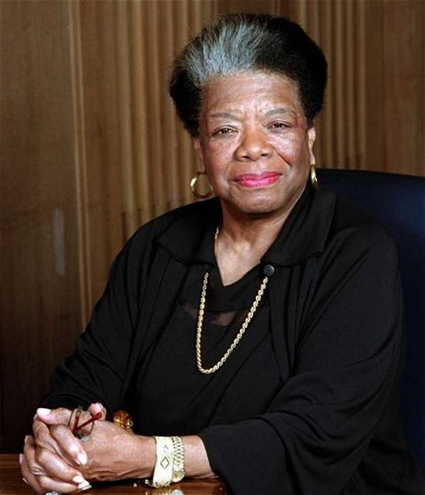
“The ship of my life may or may not be sailing on calm and amiable seas. The challenging days of my existence may or may not be bright and promising. Stormy or sunny days, glorious or lonely nights, I maintain an attitude of gratitude. If I insist on being pessimistic, there is always tomorrow. Today I am blessed."
Maya Angelou, Letter to My Daughter p. 67

Slide 3
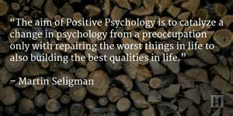
Positive Psychology

Slide 4
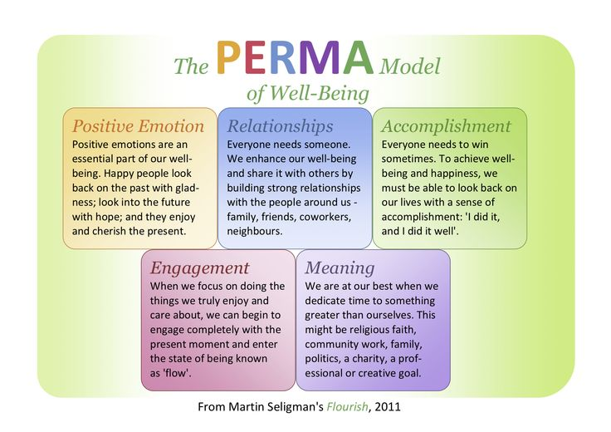

Slide 5
Flourishing
Content of flourishing:
Happiness
Flow
Meaning
Love
Gratitude
Accomplishment
Growth
Better relationships

Slide 6
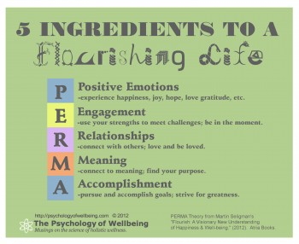
Flourishing

Slide 7
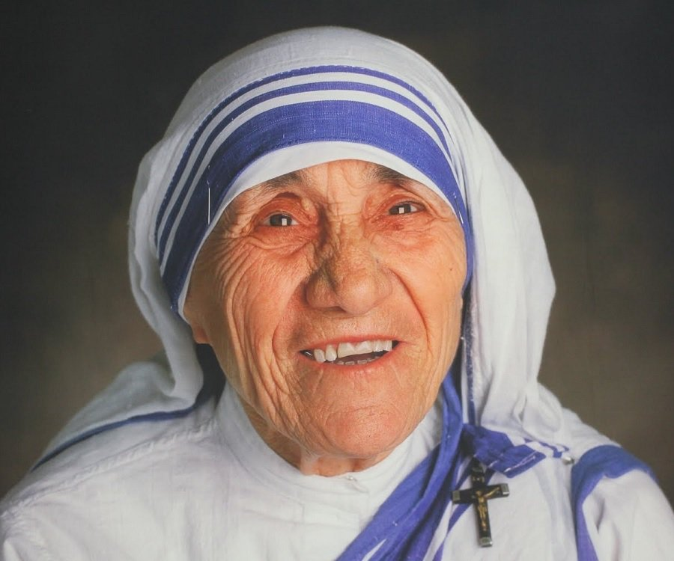
Quote
“Be happy in the moment, that's enough. Each moment is all we need, not more.” ― Mother Teresa

Slide 8
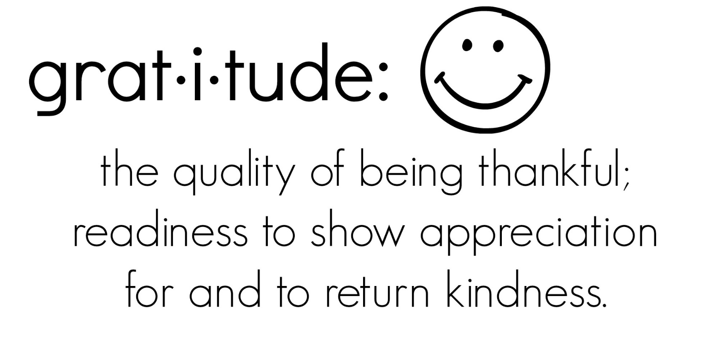
What is Gratitude?

Slide 9
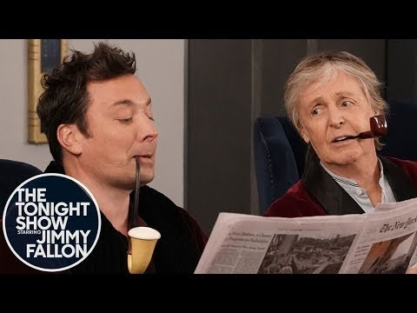
I am grateful for Jimmy Fallon and Paul McCartney

Slide 10
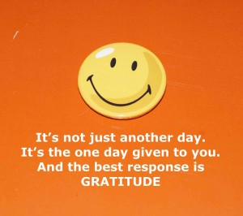
What is Gratitude?
Robert Emmons, leading scientific expert on gratitude
2 Key Components to Gratitude
1. It’s an affirmation of goodness. We affirm that there are good things in the world, gifts and benefits we’ve received
Does not ignore complaints, burdens or hassles
2. Figuring out where that goodness comes from…outside of ourselves. True gratitude involves a humble dependence on others…we acknowledge that other people (or higher powers) give us many gifs to help us achieve the goodness in our lives
http://greatergood.berkeley.edu/article/item/why_gratitude_is_good

Slide 11
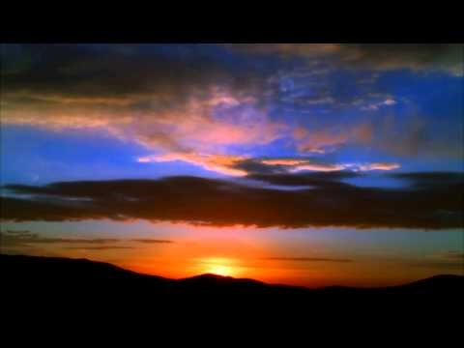
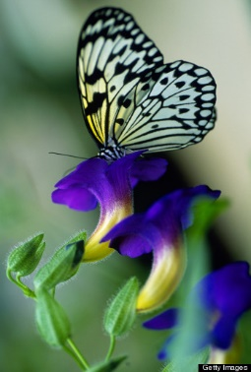
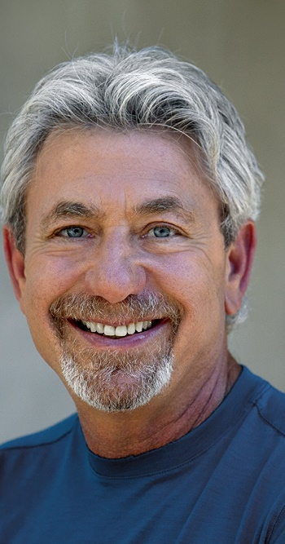
Gratitude | Louie Schwartzberg
Time Lapse Photography

Slide 12
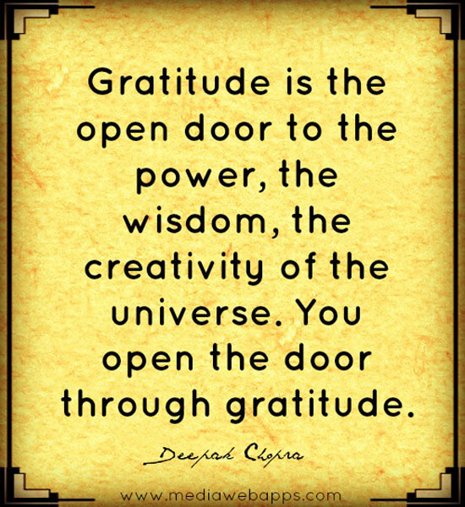
Physical Benefits of Gratitude
Stronger immune systems
Less bothered by aches and pains
Lower blood pressure
Exercise more and take better care of their health
Sleep longer and feel more refreshed upon waking
http://greatergood.berkeley.edu/article/item/why_gratitude_is_good

Slide 13
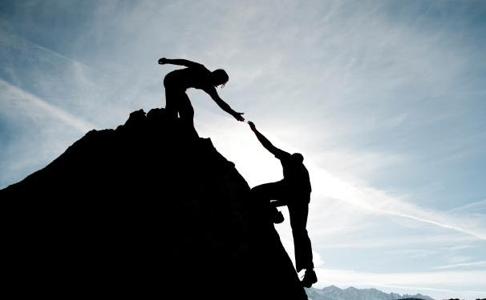
Social Benefits of Gratitude
More helpful, generous, and compassionate
More forgiving
More outgoing
Feel less lonely and isolated.
http://greatergood.berkeley.edu/article/item/why_gratitude_is_good

Slide 14
Psychological Benefits of Gratitude
Higher levels of positive emotions
More alert, alive, and awake
More joy and pleasure
More optimism and happiness
http://greatergood.berkeley.edu/article/item/why_gratitude_is_good

Slide 15
Emmons: How Does Gratitude Work?
1. Gratitude allows us to celebrate the present. It magnifies positive emotions.
Research on emotion shows that positive emotions wear off quickly. Our emotional systems like newness. They like novelty. They like change. We adapt to positive life circumstances so that before too long, the new car, the new spouse, the new house—they don’t feel so new and exciting anymore.
But gratitude makes us appreciate the value of something, and when we appreciate the value of something, we extract more benefits from it; we’re less likely to take it for granted.
In effect, I think gratitude allows us to participate more in life. We notice the positives more, and that magnifies the pleasures you get from life. Instead of adapting to goodness, we celebrate goodness. We spend so much time watching things—movies, computer screens, sports—but with gratitude we become greater participants in our lives as opposed to spectators.
http://greatergood.berkeley.edu/article/item/why_gratitude_is_good

Slide 16
Emmons: How Does Gratitude Work?
2. Gratitude blocks toxic, negative emotions, such as envy, resentment, regret—emotions that can destroy our happiness. There’s even recent evidence, including a 2008 study by psychologist Alex Wood in the Journal of Research in Personality, showing that gratitude can reduce the frequency and duration of episodes of depression.
This makes sense: You cannot feel envious and grateful at the same time. They’re incompatible feelings. If you’re grateful, you can’t resent someone for having something that you don’t. Those are very different ways of relating to the world, and sure enough, research I’ve done with colleagues Michael McCullough and Jo-Ann Tsang has suggested that people who have high levels of gratitude have low levels of resentment and envy.
http://greatergood.berkeley.edu/article/item/why_gratitude_is_good

Slide 17
Emmons: How Does Gratitude Work?
3. Grateful people are more stress resistant. There’s a number of studies showing that in the face of serious trauma, adversity, and suffering, if people have a grateful disposition, they’ll recover more quickly. I believe gratitude gives people a perspective from which they can interpret negative life events and help them guard against post-traumatic stress and lasting anxiety.
http://greatergood.berkeley.edu/article/item/why_gratitude_is_good

Slide 18
Emmons: How Does Gratitude Work?
4. Grateful people have a higher sense of self-worth. I think that’s because when you’re grateful, you have the sense that someone else is looking out for you—someone else has provided for your well-being, or you notice a network of relationships, past and present, of people who are responsible for helping you get to where you are right now.
http://greatergood.berkeley.edu/article/item/why_gratitude_is_good

Slide 19
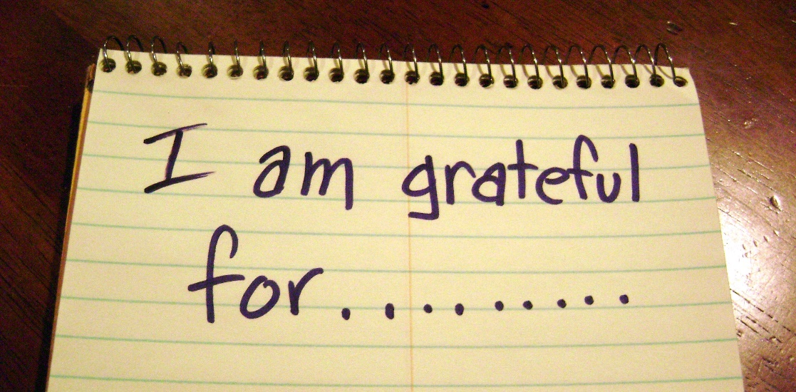
How Can We Cultivate Gratitude?
Gratitude Journal/Three Good Things
Nightly or weekly
Detail what you are grateful for
Explain why you are grateful

Slide 20
How Can We Cultivate Gratitude?
Gratitude Letter
Think of someone who you are truly grateful for but to whom you have not expressed your thankfulness
Write as if you were addressing this person directly
Describe what the person did, why you are grateful and how their behaviors influenced you
You could describe what you are doing now and how often you think about this person
Deliver the letter in person (if possible), or video chat, or send in mail

Slide 21
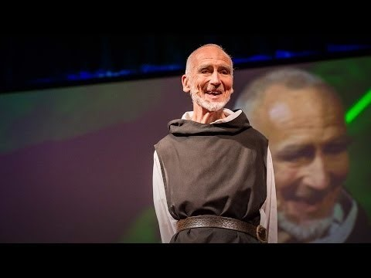
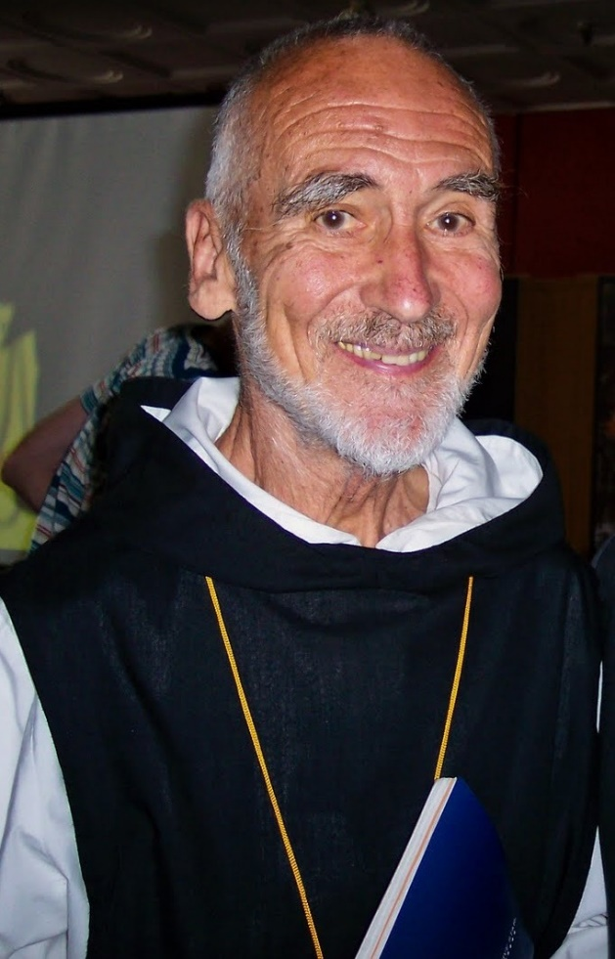
Want to be happy? Be grateful

Slide 22
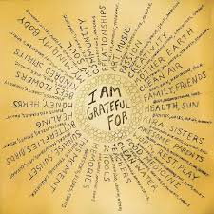
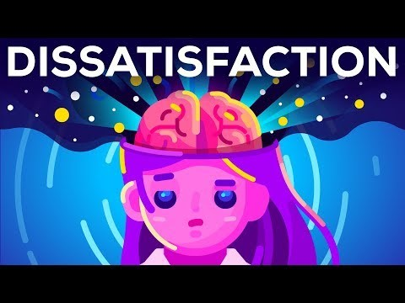
An Antidote to Dissatisfaction

Slide 23
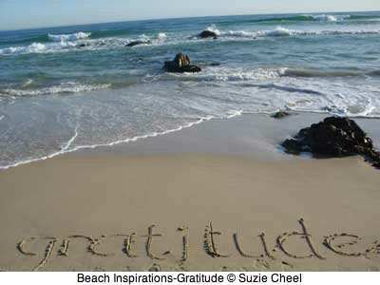
How Can We Cultivate Gratitude?
Savoring
Savoring the good in your life

Slide 24
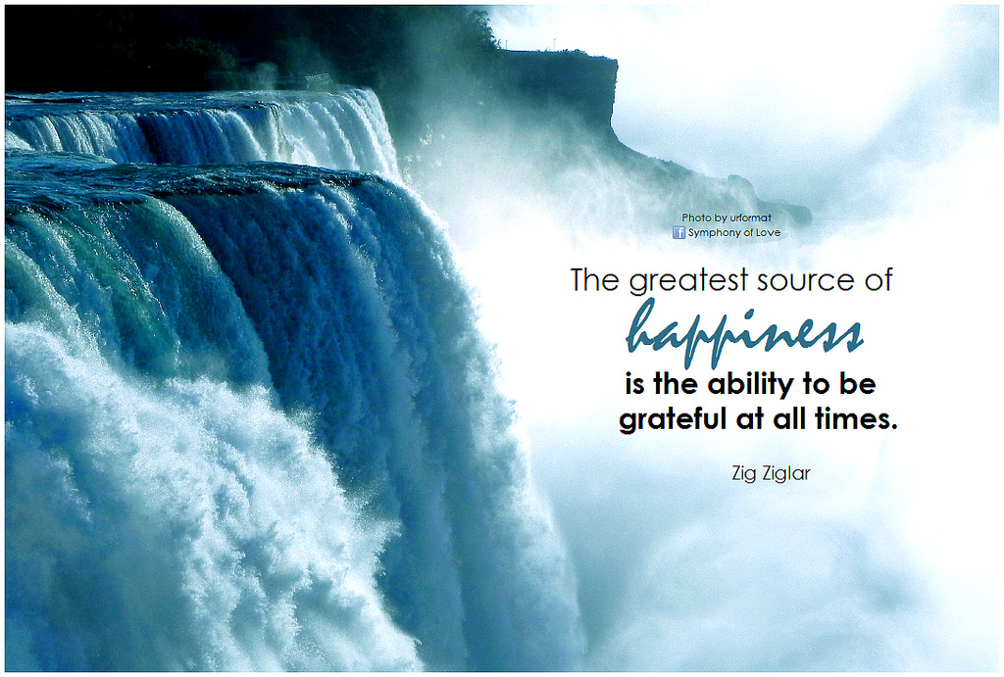

Slide 25
Fred Bryant: 10 Ways to Develop Savoring Skill
Share your good feelings with others
Take a mental photograph
Congratulate yourself
Sharpen your sensory perceptions
Shout it from the rooftops
Compare the outcome to something worse
Get absorbed in the moment
Count your blessings and give thanks
Avoid killjoy thinking (i.e., positive thoughts just as important as avoiding negative ones)
Remind yourself time flies…relish the moments

Slide 26
